Slide 1
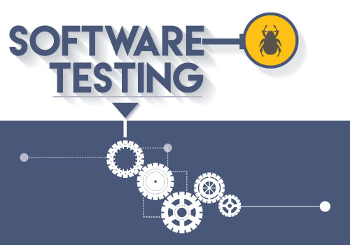
Lecture #2

Slide 2
Views of Software Quality
Views of Software Quality:
User’s view : “Does the product satisfy user needs and expectations?”
Manufacturing view : quality is understood as conformance to the specification.
Product view : product’s inherent characteristics
Value-based view : depends on the amount a
customer is willing to pay for it
Quality Models
Examples: ISO 9126, CMM, TPI(Test Process Improvement), and TMM (Test Maturity Model)

Slide 3
Quality Factors
Software Quality in terms of quality factors and criteria
A quality factor represents behavioral characteristic of a system
Examples: correctness, reliability, efficiency, testability and maintenance.
A quality criterion is an attribute of a quality factor that is related to software development
Example: modularity is an attribute of software architecture

Slide 4
Principles Of SQA
#1) Testing Shows the Presence of Defects. ...
#2) Early Testing. ...
#3) Exhaustive Testing is Not Possible. ...
#4) Testing is Context-Dependent. ...
#5) Defect Clustering. ...
#6) Pesticide Paradox. ...
#7) Absence of Error.

Slide 5
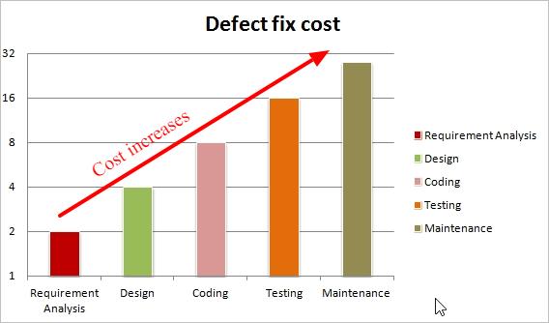

Slide 6
Role of Software Testing
test–find defects–fix cycle
software Testing assessment activities:
Static Testing
Dynamic Testing

Slide 7
VERIFICATION
And
VALIDATION

Slide 8
ST-Terms
Failure: A failure is said to occur whenever the external behavior of a
system does not conform to that prescribed in the system specification.
Error: An error is a state of the system. In the absence of any corrective action by the system, an error state could lead to a failure which would not be attributed to any event subsequent to the error.
Fault: A fault is the adjudged cause of an error.

Slide 9
Notion of Software Reliablity
Software reliability is defined as the probability of failure-free operation of a software system for a specified time in a specified environment.

Slide 10
Objectives of Testing
It does work
It does not work
Reduce the risk of failure
Reduce the cost of testing

Slide 11
TEST CASE
A test case is a simple pair of <input, expected outcome>
Stateless
State oriented

Slide 12
Values produced by the program:
State change
outcome to be valid

Slide 13
Oracle
An oracle is any entity—program, process, human expert, or body of data—that tells us the expected outcome of a particular test or set of tests

